Slide 1
Physical Database Design
Dr. Geetha Mary A, Professor, SCOPE, VIT
Slide 14-<number>
Dr. Geetha Mary A
Professor ,
SCOPE, VIT, Vellore
Sources:
Pearson Education, Inc. 2011, Elmasri/Navathe, Fundamentals of Database Systems, Sixth Edition

Slide 2
Records
Slide 13- <number>
Dr. Geetha Mary A, Professor, SCOPE, VIT
Fixed and variable length records
Records contain fields which have values of a particular type
  E.g., amount, date, time, age
Fields themselves may be fixed length or variable length
Variable length fields can be mixed into one record:
  Separator characters or length fields are needed so that the record can be “parsed.”
  separator characters (such as ? or % or $)—which do not appear in any field value—to terminate variable-length fields,

Slide 3
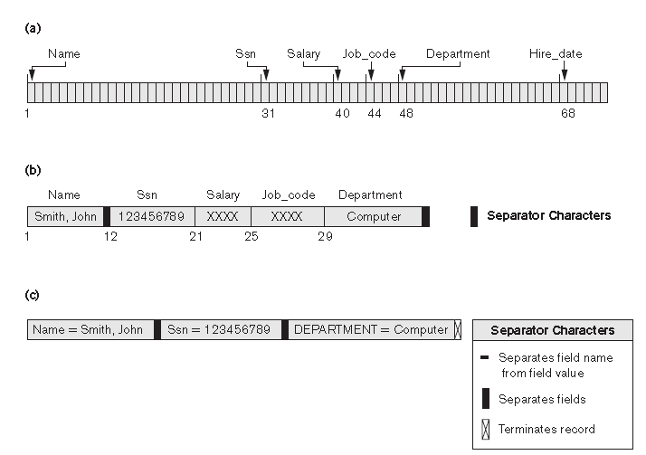
Dr. Geetha Mary A, Professor, SCOPE, VIT
Slide 14-<number>

Slide 4
Blocking
Slide 13- <number>
Dr. Geetha Mary A, Professor, SCOPE, VIT
Blocking:
  Refers to storing a number of records in one block on the disk.
Blocking factor (bfr) refers to the number of records per block.
There may be empty space in a block if an integral number of records do not fit in one block.
Spanned Records:
  Refers to records that exceed the size of one or more blocks and hence span a number of blocks.

Slide 5
Files of Records
Slide 13- <number>
Dr. Geetha Mary A, Professor, SCOPE, VIT
A file is a sequence of records, where each record is a collection of data values (or data items).
A file descriptor (or file header) includes information that describes the file, such as the field names and their data types, and the addresses of the file blocks on disk.
Records are stored on disk blocks.
The blocking factor bfr for a file is the (average) number of file records stored in a disk block.
A file can have fixed-length records or variable-length records.

Slide 6
Files of Records (contd.)
Slide 13- <number>
Dr. Geetha Mary A, Professor, SCOPE, VIT
File records can be unspanned or spanned
  Unspanned: no record can span two blocks
  Spanned: a record can be stored in more than one block
The physical disk blocks that are allocated to hold the records of a file can be contiguous, linked, or indexed.
In a file of fixed-length records, all records have the same format. Usually, unspanned blocking is used with such files.
Files of variable-length records require additional information to be stored in each record, such as separator characters and field types.
  Usually spanned blocking is used with such files.

Slide 7
Operation on Files
Slide 13- <number>
Dr. Geetha Mary A, Professor, SCOPE, VIT
Typical file operations include:
  OPEN: Readies the file for access, and associates a pointer that will refer to a current file record at each point in time.
  FIND: Searches for the first file record that satisfies a certain condition, and makes it the current file record.
  FINDNEXT: Searches for the next file record (from the current record) that satisfies a certain condition, and makes it the current file record.
  READ: Reads the current file record into a program variable.
  INSERT: Inserts a new record into the file & makes it the current file record.
  DELETE: Removes the current file record from the file, usually by marking the record to indicate that it is no longer valid.
  MODIFY: Changes the values of some fields of the current file record.
  CLOSE: Terminates access to the file.
  REORGANIZE: Reorganizes the file records.
    For example, the records marked deleted are physically removed from the file or a new organization of the file records is created.
  READ_ORDERED: Read the file blocks in order of a specific field of the file.

Slide 8
Unordered Files
Slide 13- <number>
Dr. Geetha Mary A, Professor, SCOPE, VIT
Also called a heap or a pile file.
New records are inserted at the end of the file.
A linear search through the file records is necessary to search for a record.
  This requires reading and searching half the file blocks on the average, and is hence quite expensive.
Record insertion is quite efficient.
Reading the records in order of a particular field requires sorting the file records.

Slide 9
Ordered Files
Slide 13- <number>
Dr. Geetha Mary A, Professor, SCOPE, VIT
Also called a sequential file.
File records are kept sorted by the values of an ordering field.
Insertion is expensive: records must be inserted in the correct order.
  It is common to keep a separate unordered overflow (or transaction) file for new records to improve insertion efficiency; this is periodically merged with the main ordered file.
A binary search can be used to search for a record on its ordering field value.
  This requires reading and searching log₂ of the file blocks on the average, an improvement over linear search.
Reading the records in order of the ordering field is quite efficient.

Slide 10
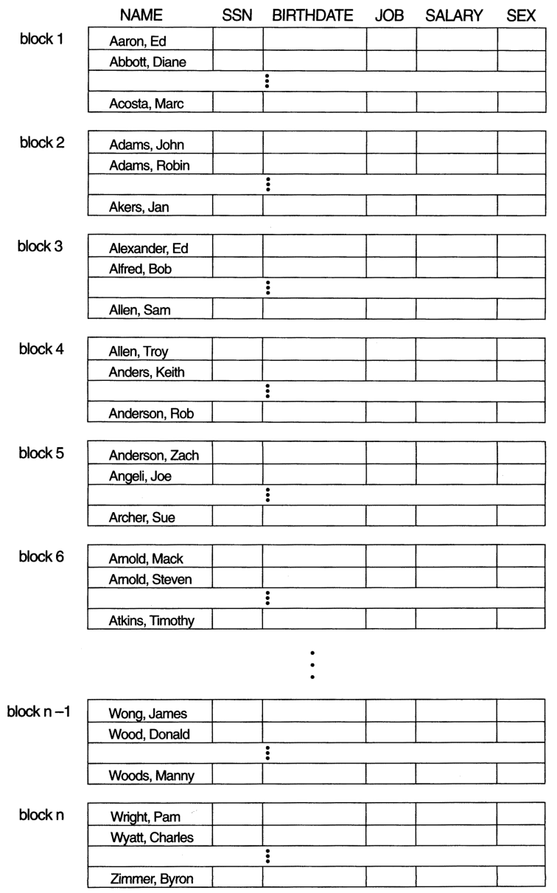
Ordered Files (contd.)
Slide 13- <number>
Dr. Geetha Mary A, Professor, SCOPE, VIT

Slide 11
Indexes as Access Paths
Slide 14- <number>
Dr. Geetha Mary A, Professor, SCOPE, VIT
A single-level index is an auxiliary file that makes it more efficient to search for a record in the data file.
The index is usually specified on one field of the file (although it could be specified on several fields)
One form of an index is a file of entries <field value, pointer to record>, which is ordered by field value
The index is called an access path on the field.

Slide 12
Indexes as Access Paths (contd.)
Slide 14- <number>
Dr. Geetha Mary A, Professor, SCOPE, VIT
The index file usually occupies considerably less disk blocks than the data file because its entries are much smaller
A binary search on the index yields a pointer to the file record
Indexes can also be characterized as dense or sparse
  A dense index has an index entry for every search key value (and hence every record) in the data file.
  A sparse (or nondense) index, on the other hand, has index entries for only some of the search values

Slide 13
Indexes as Access Paths (contd.)
Slide 14- <number>
Dr. Geetha Mary A, Professor, SCOPE, VIT
Example: Given the following data file EMPLOYEE(NAME, SSN, ADDRESS, JOB, SAL, ... )
Suppose that:
  record size R=150 bytes block size B=512 bytes r=30000 records
Then, we get:
  blocking factor Bfr= B div R= 512 div 150= 3 records/block
  number of file blocks b= (r/Bfr)= (30000/3)= 10000 blocks
For an index on the SSN field, assume the field size V_{SSN}=9 bytes, assume the record pointer size P_{R}=7 bytes. Then:
  index entry size R_{I}=(V_{SSN}+ P_{R})=(9+7)=16 bytes
  index blocking factor Bfr_{I}= B div R_{I}= 512 div 16= 32 entries/block
  number of index blocks b= (r/ Bfr_{I})= (30000/32)= 938 blocks
  binary search needs log₂bI= log₂938= 10 block accesses
  This is compared to an average linear search cost of:
    (b/2)= 30000/2= 15000 block accesses
  If the file records are ordered, the binary search cost would be:
    log₂b= log₂30000= 15 block accesses

Slide 14
Types of Single-Level Indexes
Slide 14- <number>
Dr. Geetha Mary A, Professor, SCOPE, VIT
Primary Index
  Defined on an ordered data file
  The data file is ordered on a key field
  Includes one index entry for each block in the data file; the index entry has the key field value for the first record in the block, which is called the block anchor
  A similar scheme can use the last record in a block.
  A primary index is a nondense (sparse) index, since it includes an entry for each disk block of the data file and the keys of its anchor record rather than for every search value.

Slide 15
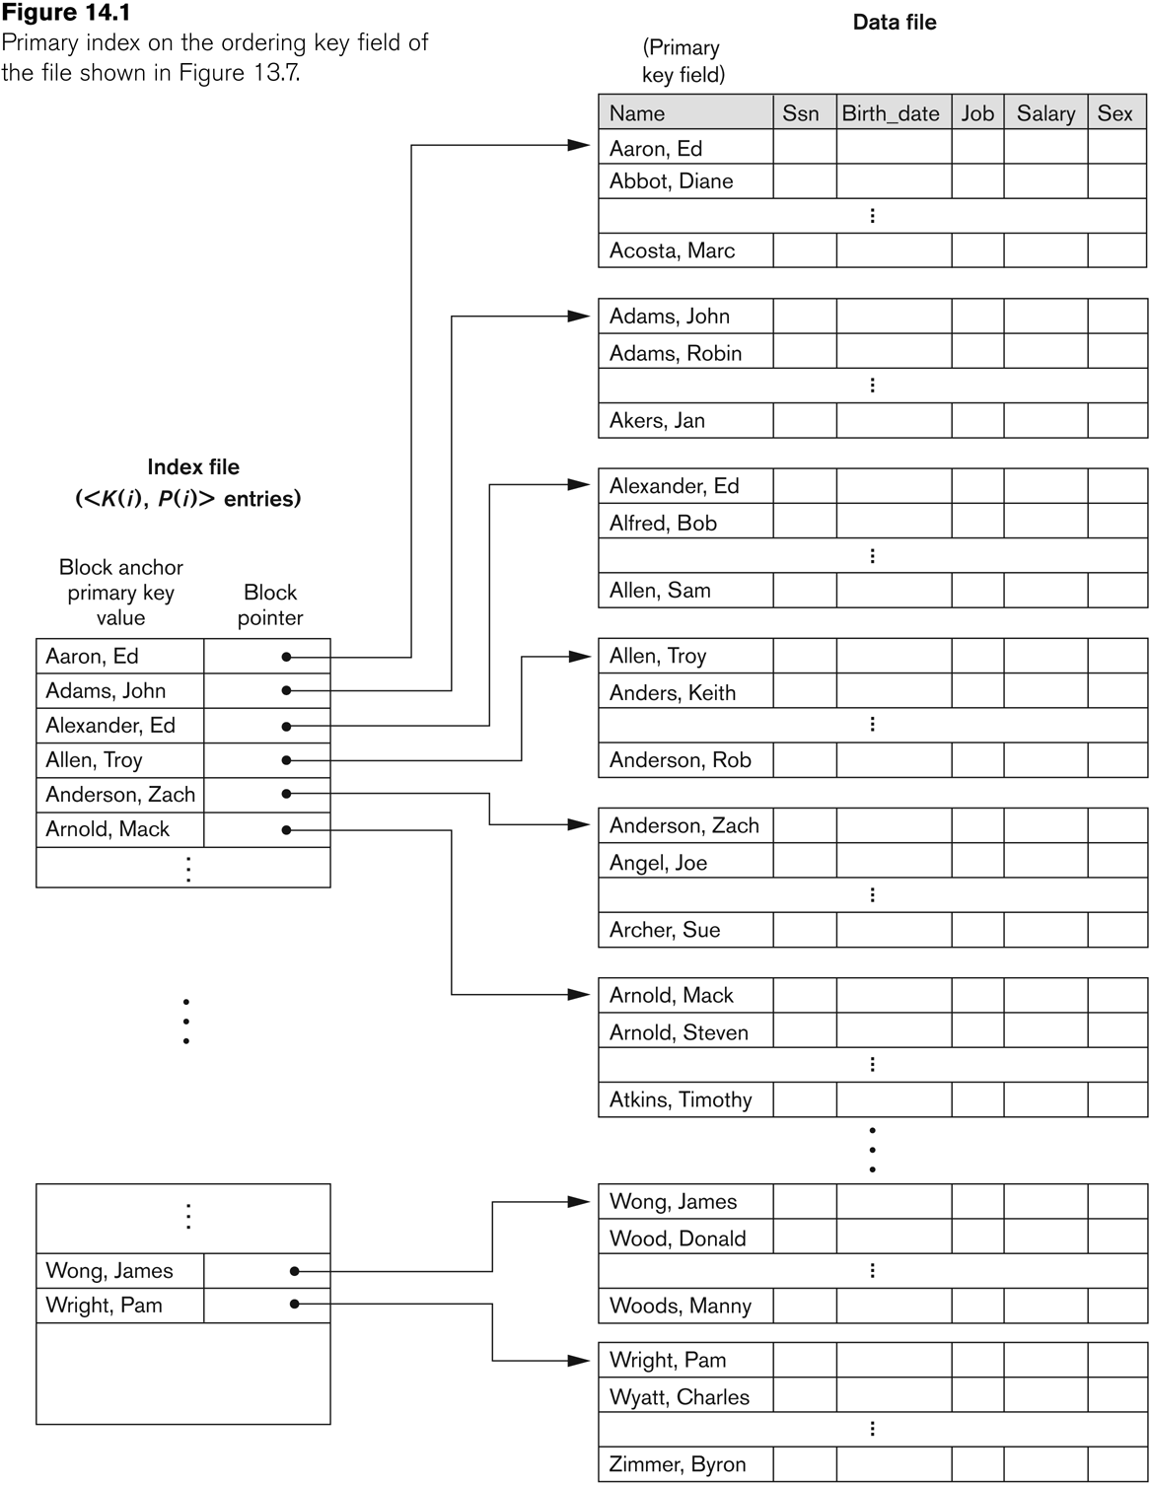
Primary index on the ordering key field
Slide 14- <number>
Dr. Geetha Mary A, Professor, SCOPE, VIT

Slide 16
Types of Single-Level Indexes
Slide 14- <number>
Dr. Geetha Mary A, Professor, SCOPE, VIT
Clustering Index
  Defined on an ordered data file
  The data file is ordered on a non-key field unlike primary index, which requires that the ordering field of the data file have a distinct value for each record.
  Includes one index entry for each distinct value of the field; the index entry points to the first data block that contains records with that field value.
  It is another example of nondense index where Insertion and Deletion is relatively straightforward with a clustering index.

Slide 17
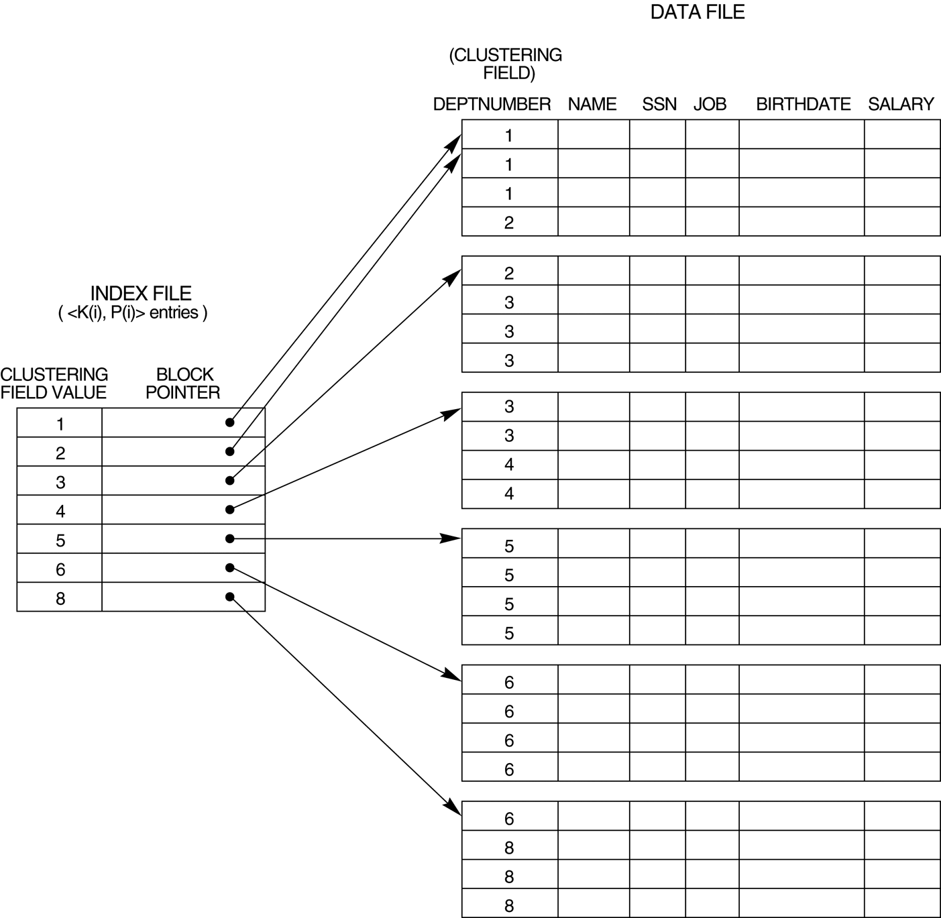
A Clustering Index Example
Slide 14- <number>
Dr. Geetha Mary A, Professor, SCOPE, VIT
FIGURE 14.2
A clustering index on the DEPTNUMBER ordering non-key field of an EMPLOYEE file.

Slide 18
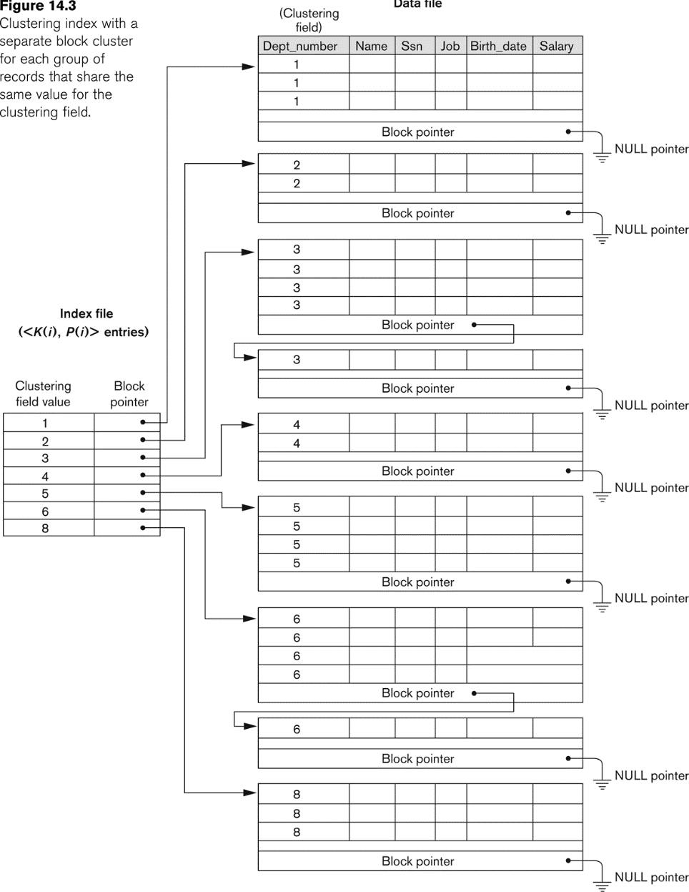
Another Clustering Index Example
Slide 14- <number>
Dr. Geetha Mary A, Professor, SCOPE, VIT

Slide 19
Types of Single-Level Indexes
Slide 14- <number>
Dr. Geetha Mary A, Professor, SCOPE, VIT
Secondary Index
  A secondary index provides a secondary means of accessing a file for which some primary access already exists.
  The secondary index may be on a field which is a candidate key and has a unique value in every record, or a non-key with duplicate values.
  The index is an ordered file with two fields.
    The first field is of the same data type as some non-ordering field of the data file that is an indexing field.
    The second field is either a block pointer or a record pointer.
    There can be many secondary indexes (and hence, indexing fields) for the same file.
  Includes one entry for each record in the data file; hence, it is a dense index

Slide 20
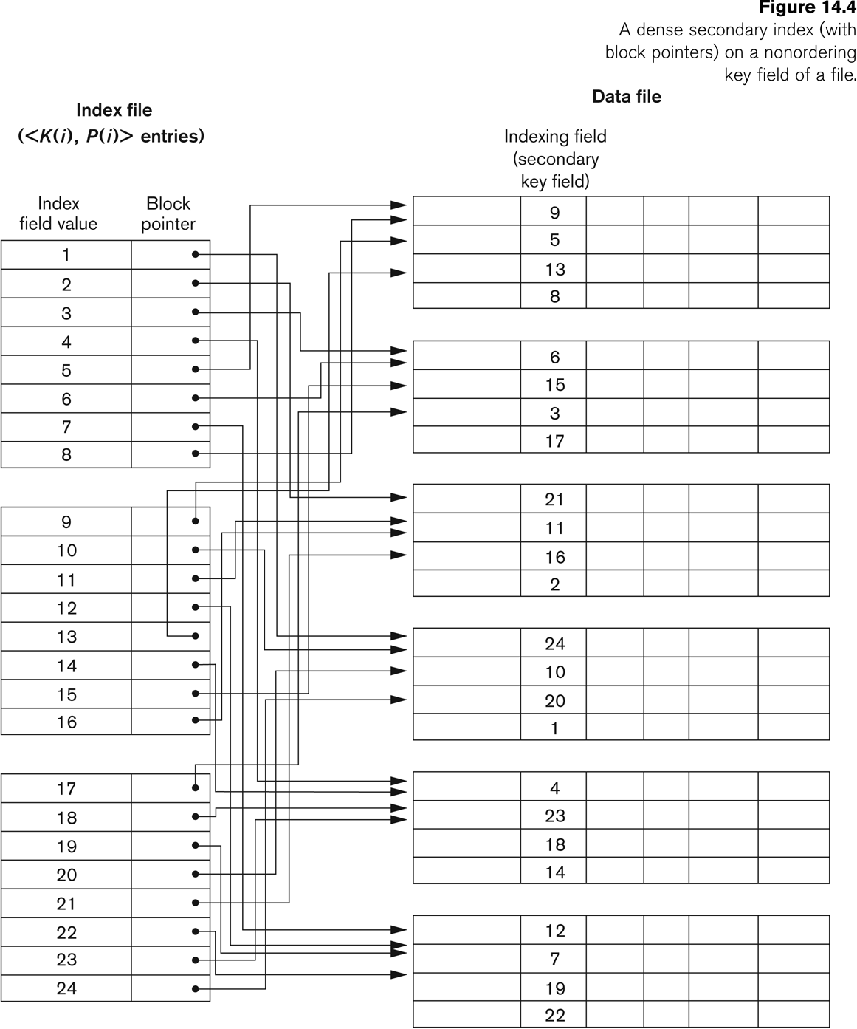
Example of a Dense Secondary Index
Slide 14- <number>
Dr. Geetha Mary A, Professor, SCOPE, VIT

Slide 21
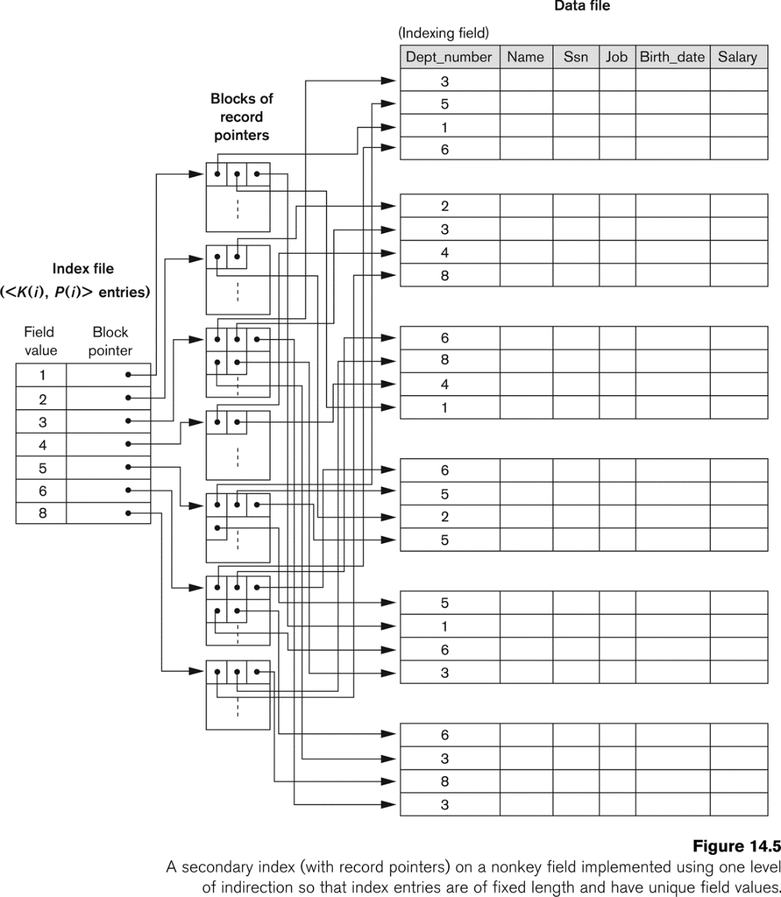
An Example of a Secondary Index
Slide 14- <number>
Dr. Geetha Mary A, Professor, SCOPE, VIT

Slide 22
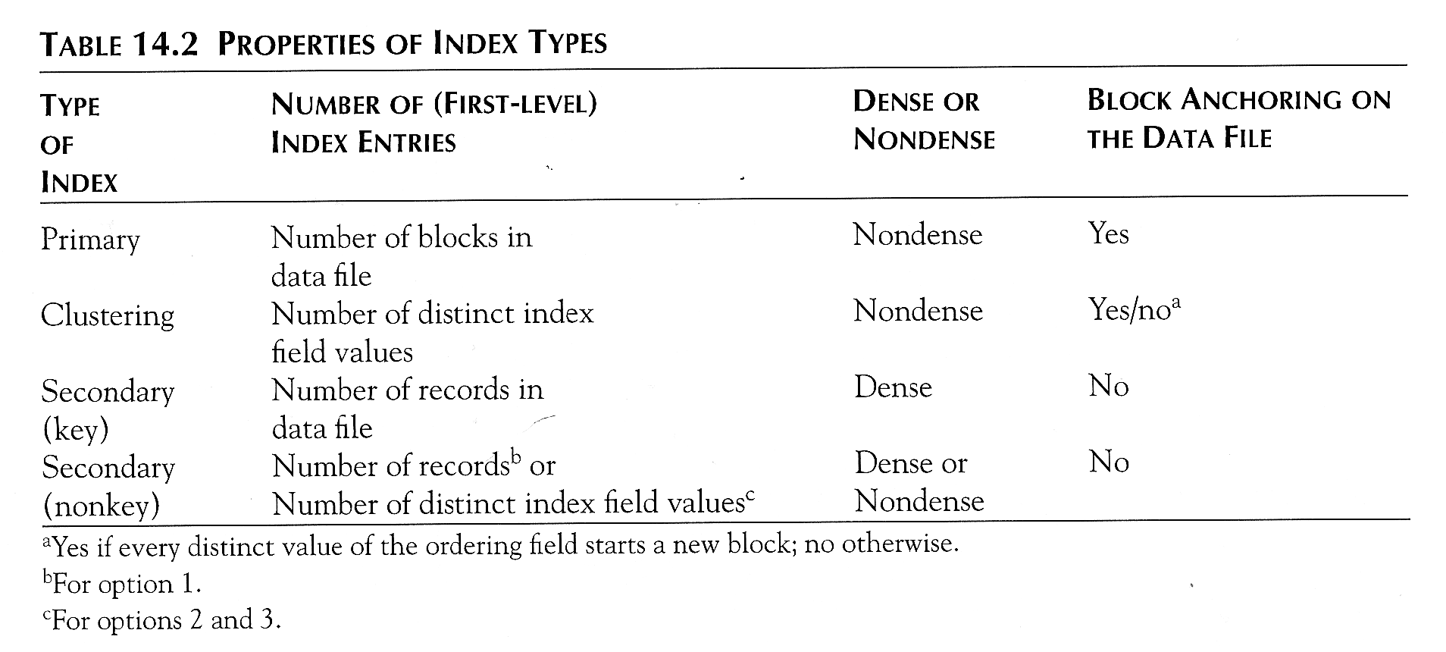
Properties of Index Types
Slide 14- <number>
Dr. Geetha Mary A, Professor, SCOPE, VIT

Slide 23
Multi-Level Indexes
Slide 14- <number>
Dr. Geetha Mary A, Professor, SCOPE, VIT
Because a single-level index is an ordered file, we can create a primary index to the index itself;
  In this case, the original index file is called the first-level index and the index to the index is called the second-level index.
We can repeat the process, creating a third, fourth, ..., top level until all entries of the top level fit in one disk block
A multi-level index can be created for any type of first-level index (primary, secondary, clustering) as long as the first-level index consists of more than one disk block

Slide 24
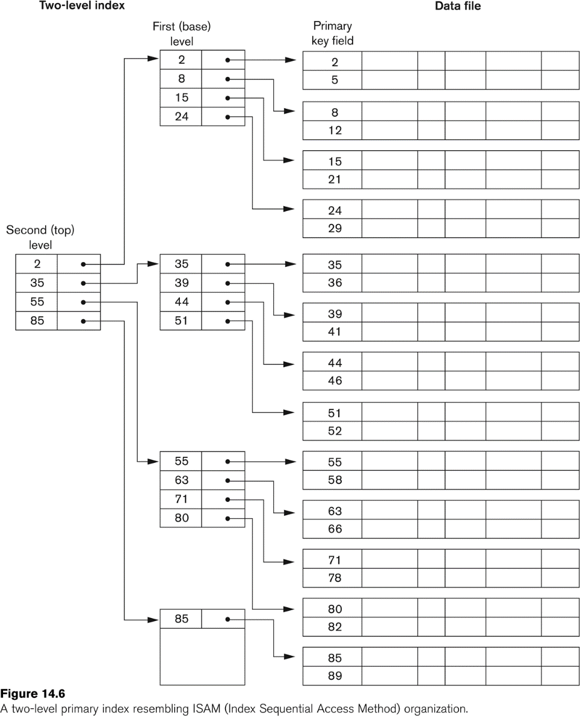
A Two-level Primary Index
Slide 14- <number>
Dr. Geetha Mary A, Professor, SCOPE, VIT

Slide 25
Multi-Level Indexes
Slide 14- <number>
Dr. Geetha Mary A, Professor, SCOPE, VIT
Such a multi-level index is a form of search tree
  However, insertion and deletion of new index entries is a severe problem because every level of the index is an ordered file.

Slide 26
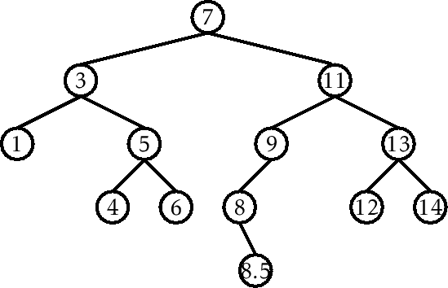
Binary search tree
Dr. Geetha Mary A, Professor, SCOPE, VIT
Slide 14-<number>

Slide 27
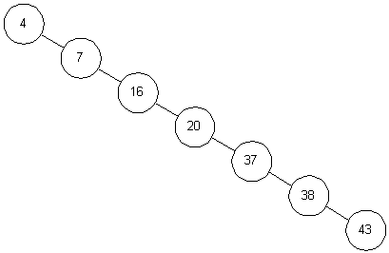
Dr. Geetha Mary A, Professor, SCOPE, VIT
Slide 14-<number>

Slide 28
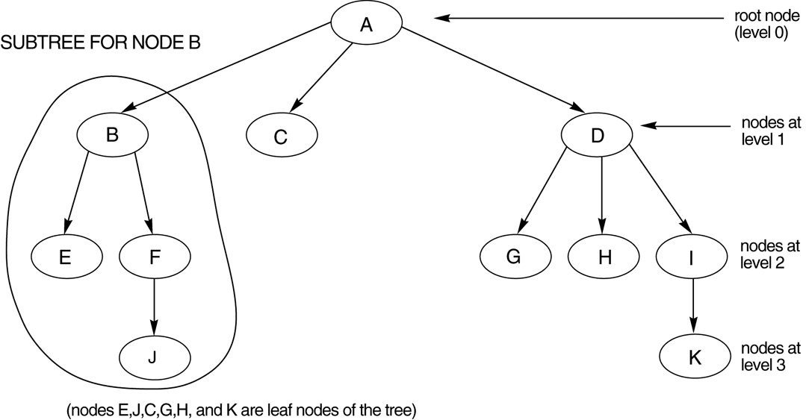
A tree data structure that shows an unbalanced tree.
Dr. Geetha Mary A, Professor, SCOPE, VIT
Slide 14-<number>

Slide 29
Dynamic Multilevel Indexes Using B-Trees and B+-Trees
Slide 14- <number>
Dr. Geetha Mary A, Professor, SCOPE, VIT
Most multi-level indexes use B-tree or B+-tree data structures because of the insertion and deletion problem
  This leaves space in each tree node (disk block) to allow for new index entries
These data structures are variations of search trees that allow efficient insertion and deletion of new search values.
In B-Tree and B+-Tree data structures, each node corresponds to a disk block
Each node is kept between half-full and completely full

Slide 30
Dynamic Multilevel Indexes Using B-Trees and B+-Trees (contd.)
Slide 14- <number>
Dr. Geetha Mary A, Professor, SCOPE, VIT
An insertion into a node that is not full is quite efficient
  If a node is full the insertion causes a split into two nodes
Splitting may propagate to other tree levels
A deletion is quite efficient if a node does not become less than half full
If a deletion causes a node to become less than half full, it must be merged with neighboring nodes

Slide 31
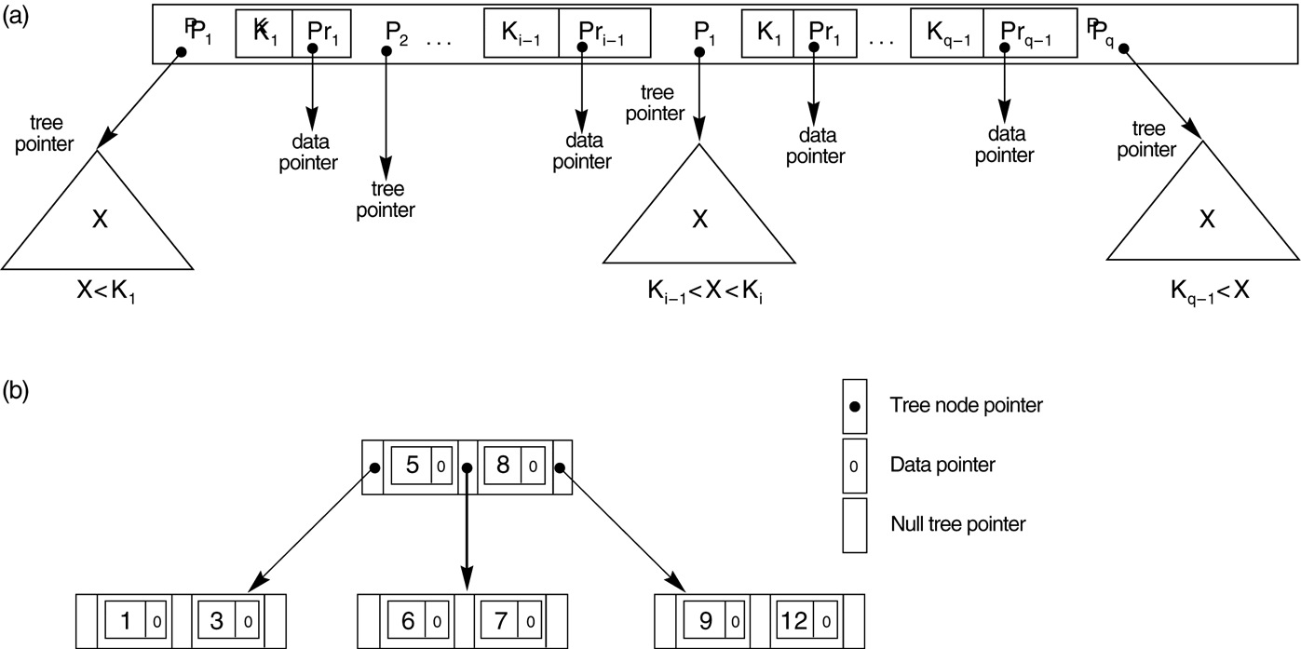
B-tree structures. (a) A node in a B-tree with q – 1 search values
Dr. Geetha Mary A, Professor, SCOPE, VIT
Slide 14-<number>

Slide 32
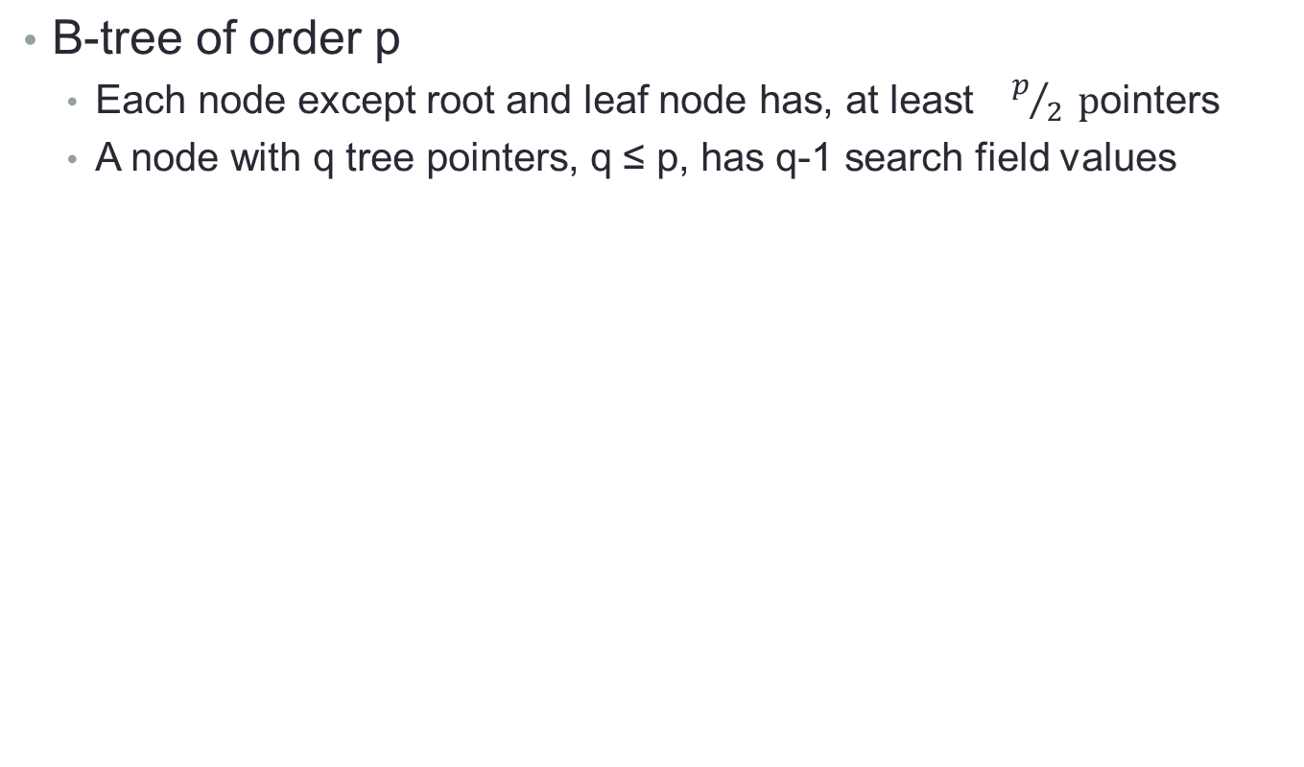
B-tree
Dr. Geetha Mary A, Professor, SCOPE, VIT
Slide 14-<number>

Slide 33
A B-tree of order p = 3. The values were inserted in the order 8, 5, 1, 7, 3, 12, 9, 6.
Dr. Geetha Mary A, Professor, SCOPE, VIT
Slide 14-<number>

Slide 34
An example B-Tree
Dr. Geetha Mary A, Professor, SCOPE, VIT
Slide 14-<number>
26
A B-tree of order 5 containing 26 items
6
12
42
51
62
1
2
4
7
8
13
15
18
25
27
29
45
46
48
53
55
60
64
70
90
Note that all the leaves are at the same level

Slide 35
Constructing a B-tree
Dr. Geetha Mary A, Professor, SCOPE, VIT
Suppose we start with an empty B-tree and keys arrive in the following order:1 12 8 2 25 5 14 28 17 7 52 16 48 68 3 26 29 53 55 45
We want to construct a B-tree of order 5
The first four items go into the root:
To put the fifth item in the root would violate condition 5
Therefore, when 25 arrives, pick the middle key to make a new root
1
2
8
12

Slide 36
Constructing a B-tree (contd.)
Dr. Geetha Mary A, Professor, SCOPE, VIT
8
1
2
12
25
6, 14, 28 get added to the leaf nodes:
8
1
2
6
12
14
25
28

Slide 37
Constructing a B-tree (contd.)
Dr. Geetha Mary A, Professor, SCOPE, VIT
Adding 17 to the right leaf node would over-fill it, so we take the middle key, promote it (to the root) and split the leaf
8
17
1
2
6
12
14
25
28
7, 52, 16, 48 get added to the leaf nodes
8
17
1
2
6
7
12
14
16
25
28
48
52

Slide 38
Constructing a B-tree (contd.)
Dr. Geetha Mary A, Professor, SCOPE, VIT
Adding 68 causes us to split the right most leaf, promoting 48 to the root, and adding 3 causes us to split the left most leaf, promoting 3 to the root; 26, 29, 53, 55 then go into the leaves
3
8
17
48
1
2
6
7
12
14
16
25
26
28
29
52
53
55
68
Adding 45 causes a split of
25
26
28
29
and promoting 28 to the root then causes the root to split

Slide 39
Constructing a B-tree (contd.)
Dr. Geetha Mary A, Professor, SCOPE, VIT
17
3
8
28
48
1
2
6
7
12
14
16
25
26
29
45
52
53
55
68

Slide 40
Type #1: Simple leaf deletion
Dr. Geetha Mary A, Professor, SCOPE, VIT
Assuming a 5-way
B-Tree, as before...
12
29
52
2
7
9
15
22
31
43
56
69
72
Delete 2: Since there are enough
keys in the node, just delete it
Note when printed: this slide is animated

Slide 41
Type #2: Simple non-leaf deletion
Dr. Geetha Mary A, Professor, SCOPE, VIT
12
29
52
Delete 52
56
7
9
15
22
31
43
56
69
72
Borrow the predecessor
or (in this case) successor
Note when printed: this slide is animated

Slide 42
Type #4: Too few keys in node and its siblings
Dr. Geetha Mary A, Professor, SCOPE, VIT
12
29
56
Join back together
7
9
15
22
31
43
69
72
Too few keys!
Delete 72
Note when printed: this slide is animated

Slide 43
Type #4: Too few keys in node and its siblings
Dr. Geetha Mary A, Professor, SCOPE, VIT
12
29
7
9
15
22
31
43
56
69
Note when printed: this slide is animated

Slide 44
Type #3: Enough siblings
Dr. Geetha Mary A, Professor, SCOPE, VIT
12
29
Demote root key and
promote leaf key
7
9
15
22
31
43
56
69
Delete 22
Note when printed: this slide is animated

Slide 45
Type #3: Enough siblings
Dr. Geetha Mary A, Professor, SCOPE, VIT
12
31
7
9
15
29
43
56
69
Note when printed: this slide is animated

Slide 46
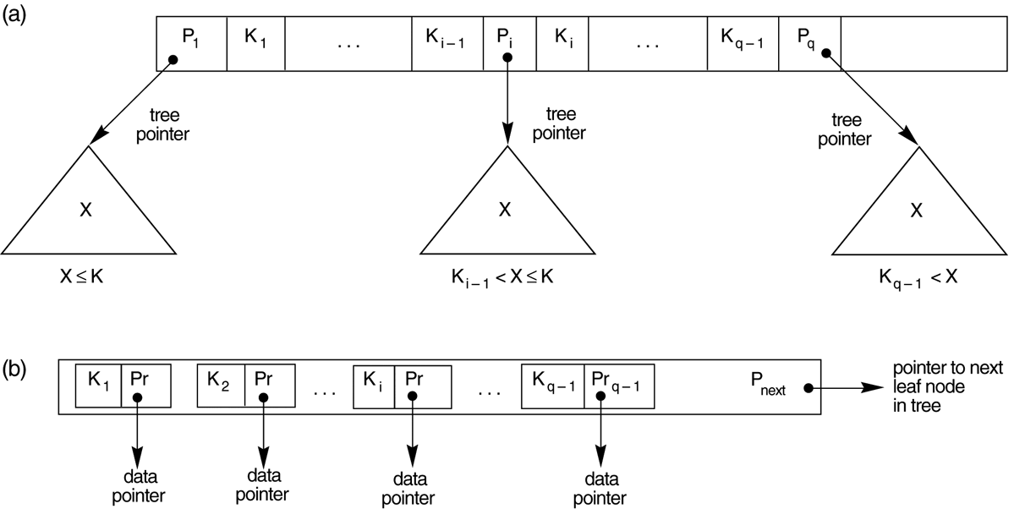
The nodes of a B+-tree. (a) Internal node of a B+-tree with q –1 search values. (b) Leaf node of a B+-tree with q – 1 search values and q – 1 data pointers.
Dr. Geetha Mary A, Professor, SCOPE, VIT
Slide 14-<number>

Slide 47
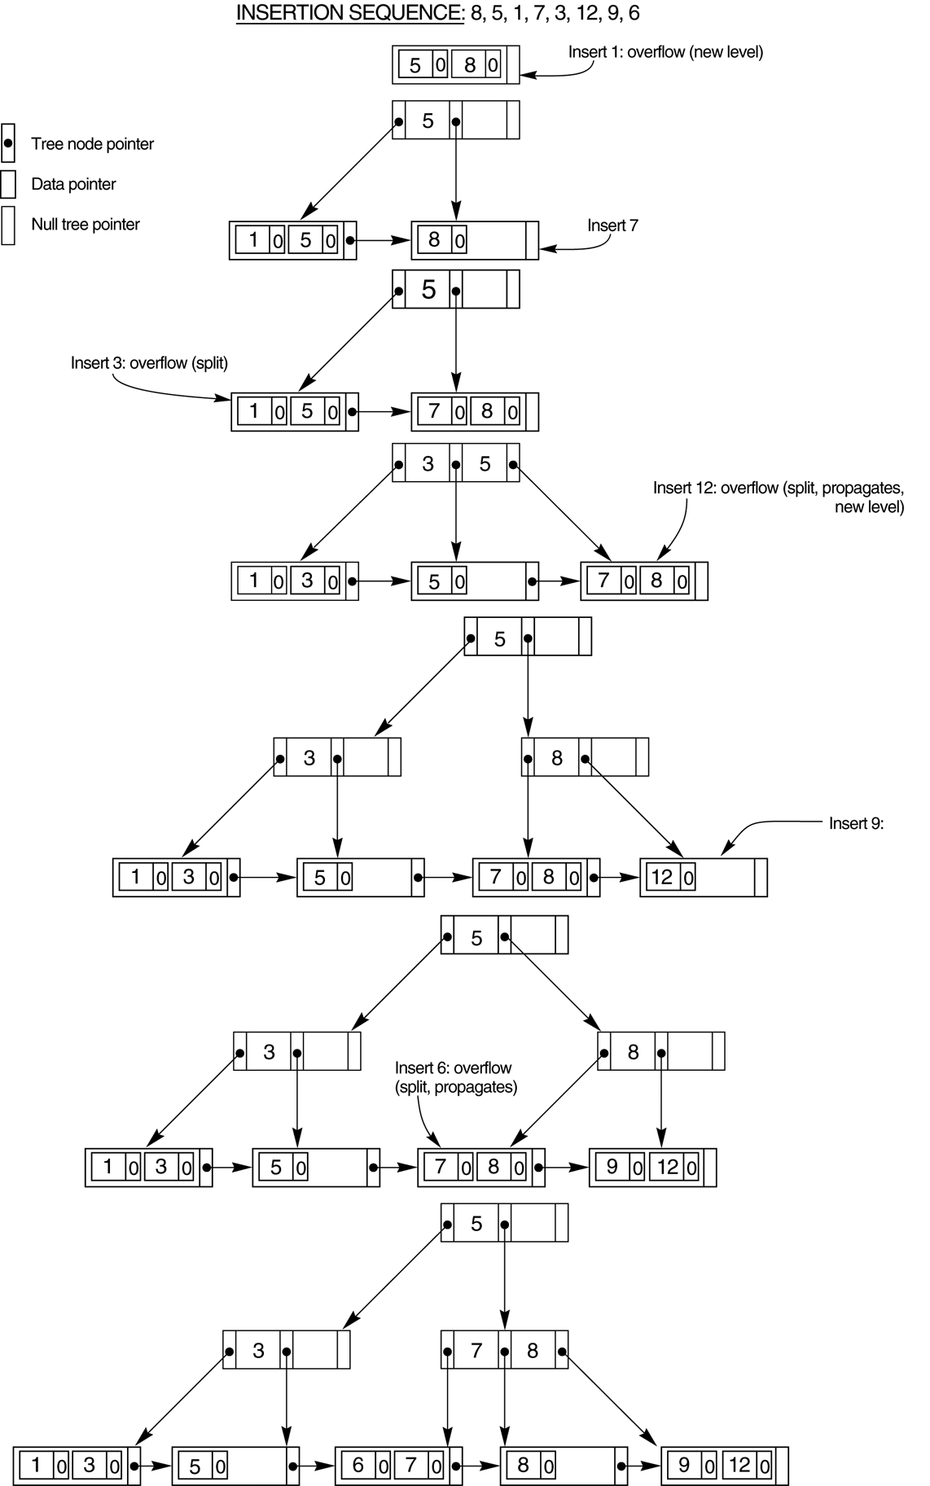
An example of insertion in a B+-tree with q = 3 and p_{leaf} = 2.
Dr. Geetha Mary A, Professor, SCOPE, VIT
Slide 14-<number>

Slide 48
An example of insertion in a B+-tree with q = 3 and p_{leaf} = 2.
Dr. Geetha Mary A, Professor, SCOPE, VIT
Slide 14-<number>

Slide 49
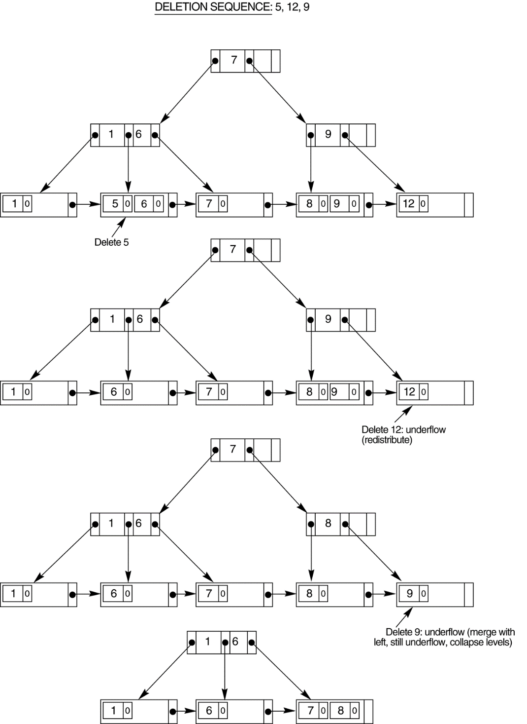
An example of deletion from a
B+-tree.
Dr. Geetha Mary A, Professor, SCOPE, VIT
Slide 14-<number>

Slide 50
Hashed Files
Dr. Geetha Mary A, Professor, SCOPE, VIT
Slide 14-<number>
Hashing for disk files is called External Hashing
The file blocks are divided into M equal-sized buckets, numbered bucket₀, bucket₁, ..., bucket_{M-1}.
  Typically, a bucket corresponds to one (or a fixed number of) disk block.
One of the file fields is designated to be the hash key of the file.
The record with hash key value K is stored in bucket i, where i=h(K), and h is the hashing function.
Search is very efficient on the hash key.
Collisions occur when a new record hashes to a bucket that is already full.
  An overflow file is kept for storing such records.
  Overflow records that hash to each bucket can be linked together.

Slide 51
Hashed Files (contd.)
Dr. Geetha Mary A, Professor, SCOPE, VIT
Slide 14-<number>
There are numerous methods for collision resolution, including the following:
  Open addressing: Proceeding from the occupied position specified by the hash address, the program checks the subsequent positions in order until an unused (empty) position is found.
  Chaining: For this method, various overflow locations are kept, usually by extending the array with a number of overflow positions. In addition, a pointer field is added to each record location. A collision is resolved by placing the new record in an unused overflow location and setting the pointer of the occupied hash address location to the address of that overflow location.
  Multiple hashing: The program applies a second hash function if the first results in a collision. If another collision results, the program uses open addressing or applies a third hash function and then uses open addressing if necessary.

Slide 52
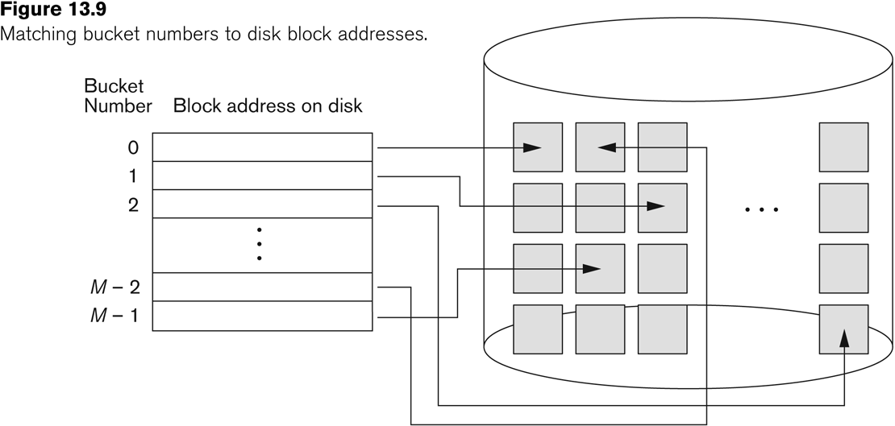
Hashed Files (contd.)
Dr. Geetha Mary A, Professor, SCOPE, VIT
Slide 14-<number>

Slide 53
Hashed Files (contd.)
Dr. Geetha Mary A, Professor, SCOPE, VIT
Slide 14-<number>
To reduce overflow records, a hash file is typically kept 70-80% full.
The hash function h should distribute the records uniformly among the buckets
  Otherwise, search time will be increased because many overflow records will exist.
Main disadvantages of static external hashing:
  Fixed number of buckets M is a problem if the number of records in the file grows or shrinks.
  Ordered access on the hash key is quite inefficient (requires sorting the records).

Slide 54
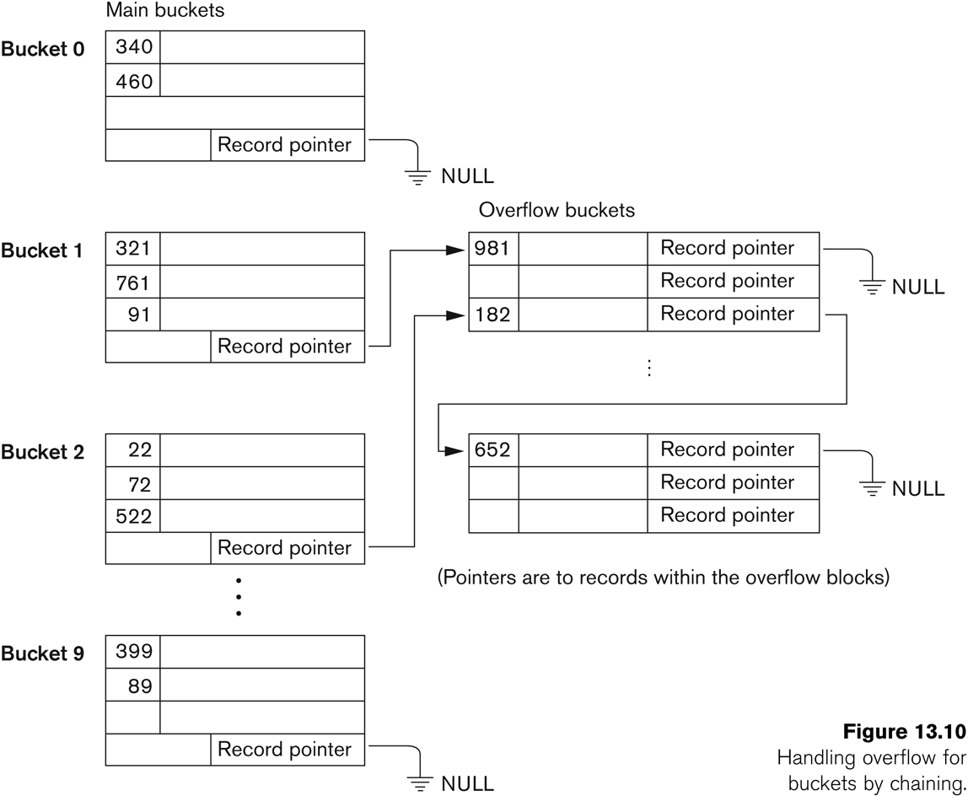
Hashed Files - Overflow handling
Dr. Geetha Mary A, Professor, SCOPE, VIT
Slide 14-<number>

Slide 55
Dynamic And Extendible Hashed Files
Dr. Geetha Mary A, Professor, SCOPE, VIT
Slide 14-<number>
Dynamic and Extendible Hashing Techniques
  Hashing techniques are adapted to allow the dynamic growth and shrinking of the number of file records.
  These techniques include the following: dynamic hashing, extendible hashing, and linear hashing.
Both dynamic and extendible hashing use the binary representation of the hash value h(K) in order to access a directory.
  In dynamic hashing the directory is a binary tree.
  In extendible hashing the directory is an array of size 2^{d} where d is called the global depth.

Slide 56
Dynamic And Extendible Hashing (contd.)
Dr. Geetha Mary A, Professor, SCOPE, VIT
Slide 14-<number>
The directories can be stored on disk, and they expand or shrink dynamically.
  Directory entries point to the disk blocks that contain the stored records.
An insertion in a disk block that is full causes the block to split into two blocks and the records are redistributed among the two blocks.
  The directory is updated appropriately.
Dynamic and extendible hashing do not require an overflow area.
Linear hashing does require an overflow area but does not use a directory.
  Blocks are split in linear order as the file expands.

Slide 57
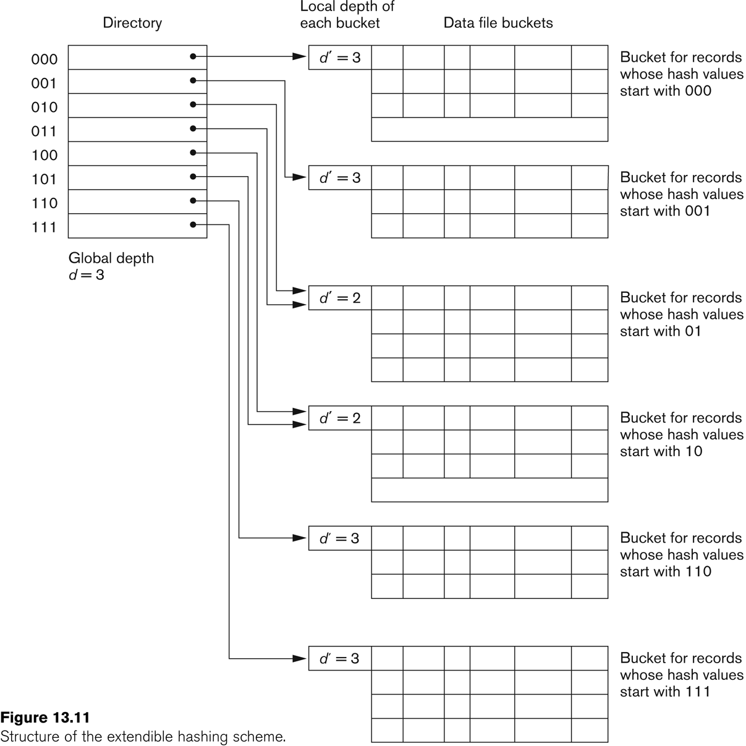
Extendible Hashing
Dr. Geetha Mary A, Professor, SCOPE, VIT
Slide 14-<number>

